Slide 1
EEGR 471
Section 1: Simulation

Slide 2
Section Outline
Introduction
Logic Specifications
Test plans
Simulation
Cycle vs Event based
Testbenches
Directed vs Layered
Methodology
Formal

Slide 3
Section Outcome
Introduce concepts and tools necessary for proper verification
Layout process of performing effective functional verification
Present techniques for applying effective stimulus and monitors design responses as a result.
Explain benefits of bus functional models and how to implement them.

Slide 4
Prior Knowledge
This section is focused on verification of described/simulatable hardware design…. So VHDL or Verilog
Students are expected to have basic knowledge of one of these description languages.
We will be reviewing and verifying digital designs, so basic knowledge of logic design.
We will be going over SystemVerilog which in simulation is mostly class based.
So… some understanding of Object-Oriented Programming is expected.

Slide 5

BACKGROUND
ICs are an integral part of daily life in 2023.
Included in everything:
Phones
TV’s
Laptops
Watches
Earphones
and yes, even Fridges.

Slide 6
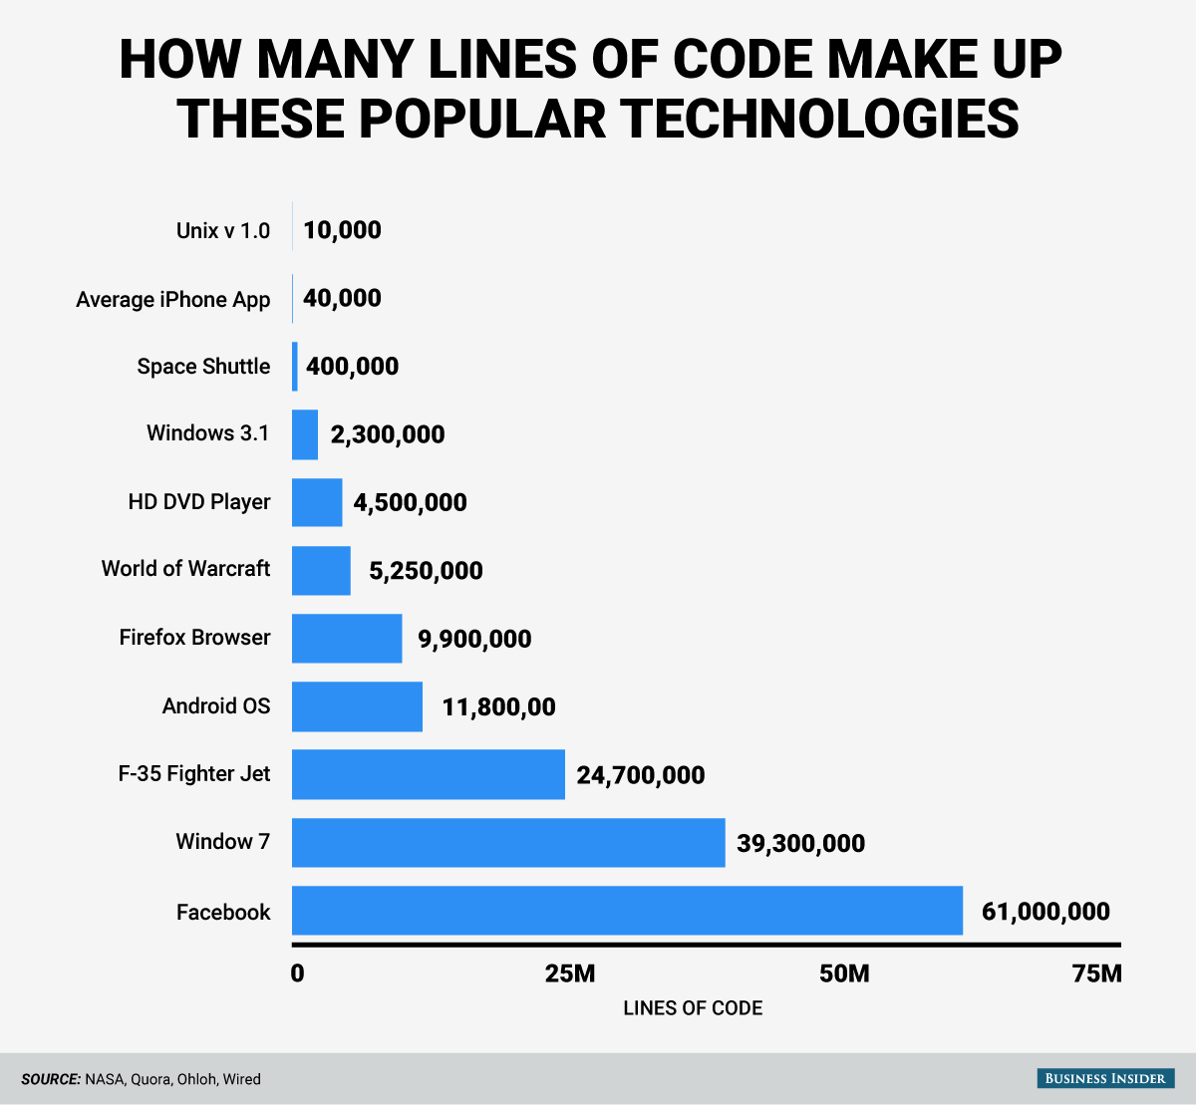
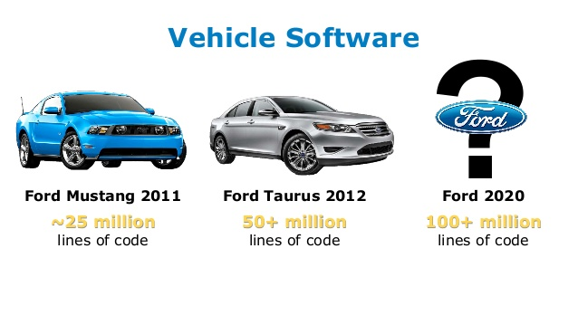
HW/SW Systems
Complexity in Lines of Code
Notes:
Adapted from : https://ati.ttu.ee/~jaan/verification/1_introduction%20english.ppt

Slide 7
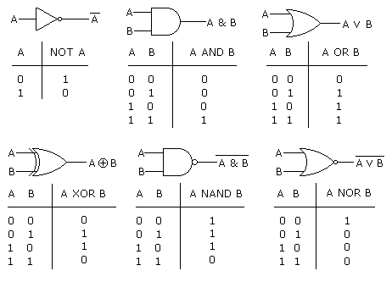
Building blocks: Logic Gates
At the heart of IC’s are logic gates.. Combined into complex systems

Slide 8
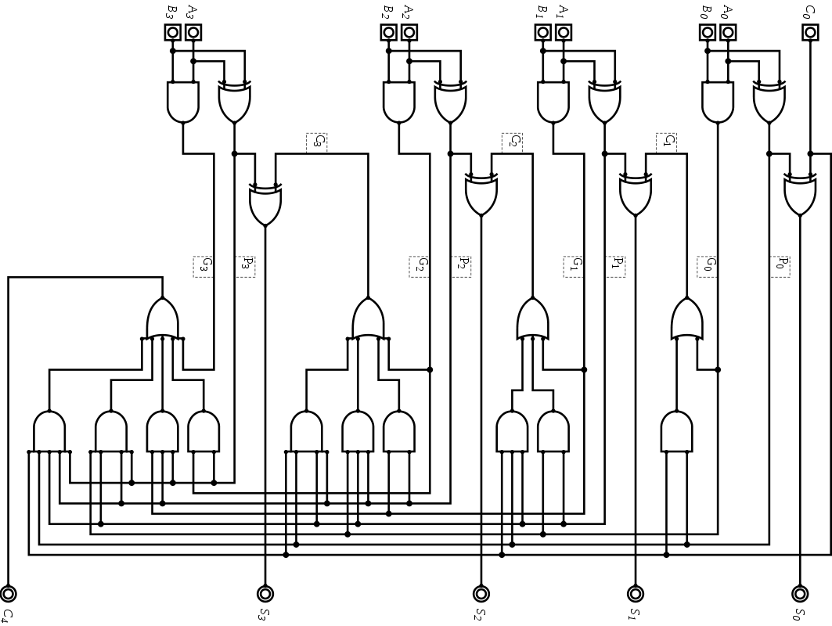
Sea of Gates

Slide 9
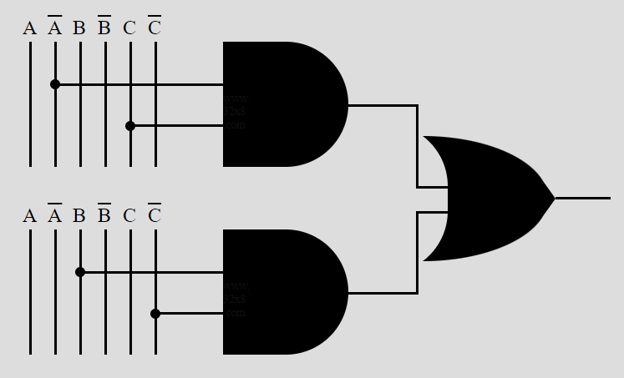
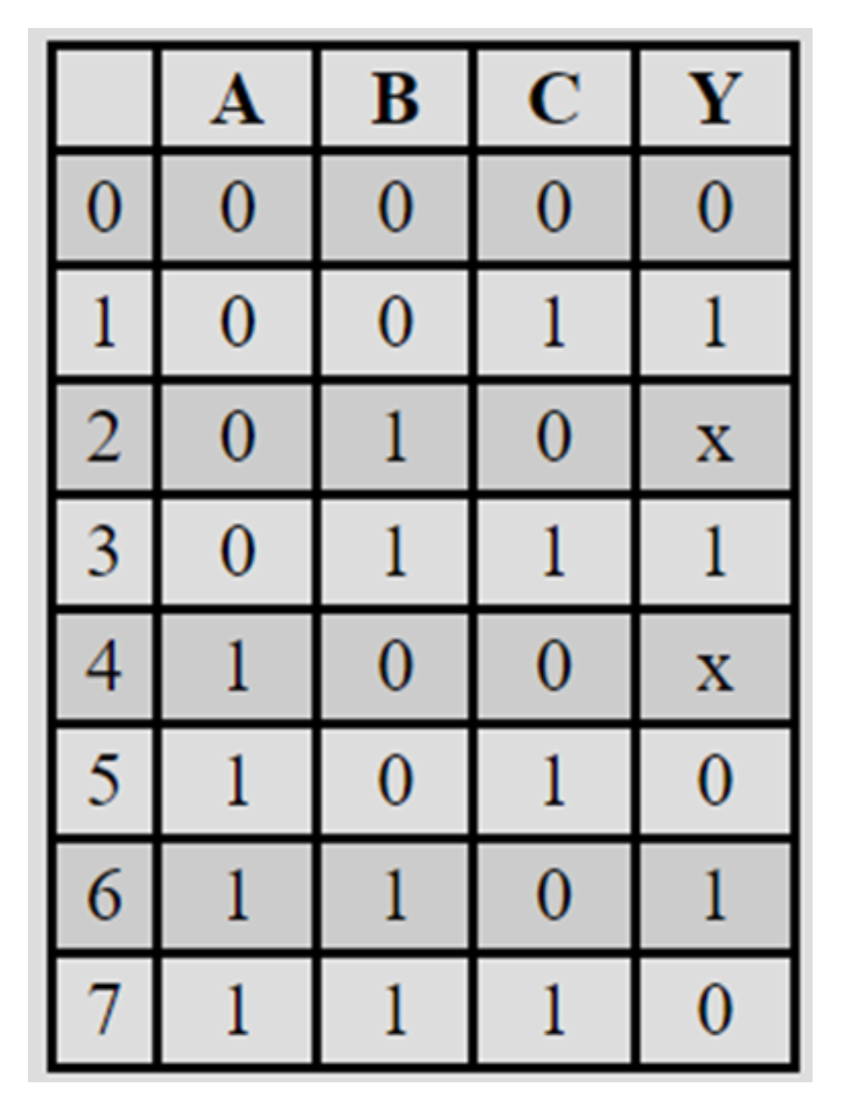
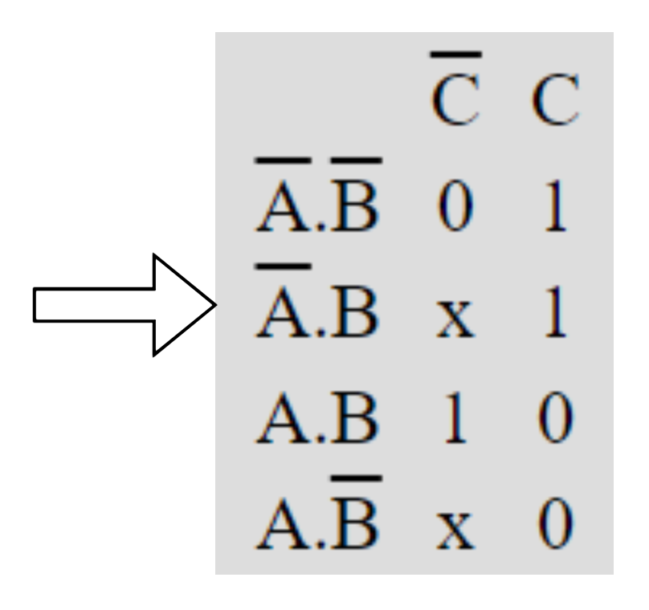
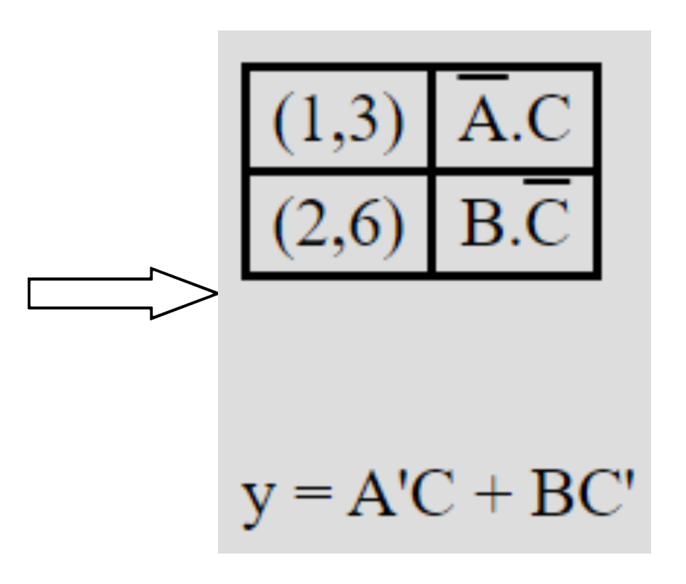
Logic Design: Early Days
Write out logic by hand
Truth Tables, K-maps, State tables.

Slide 10
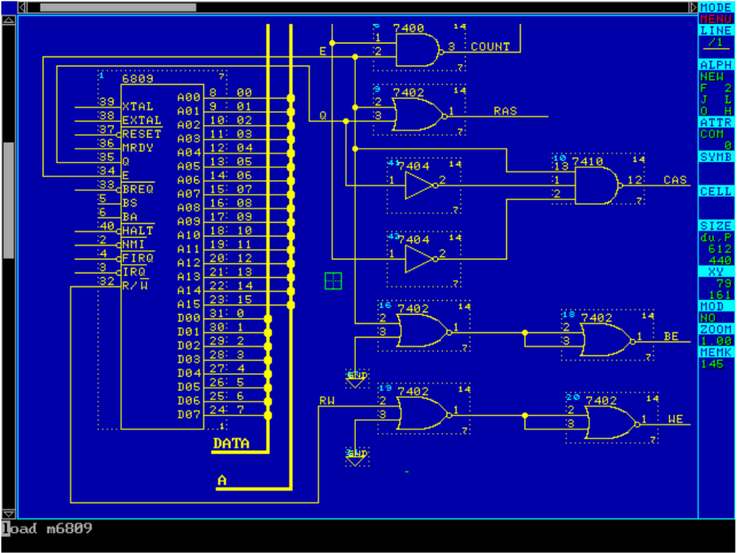
Logic Design: Middle Ages
Schematic Entry
Draw design gate by gate.
then map to available resources.
Notes:
Cs.cornell.edu/courses/cs3410/2019sp/riscv/interpreter/

Slide 11
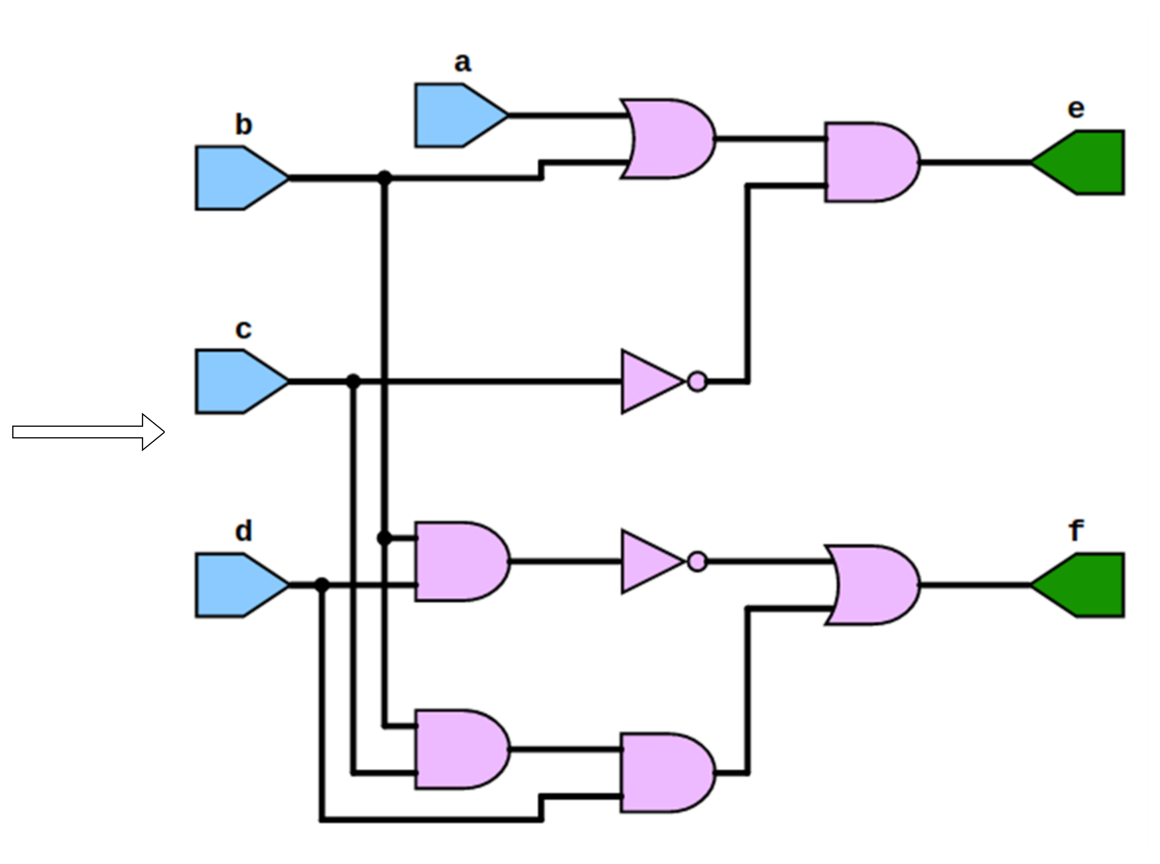
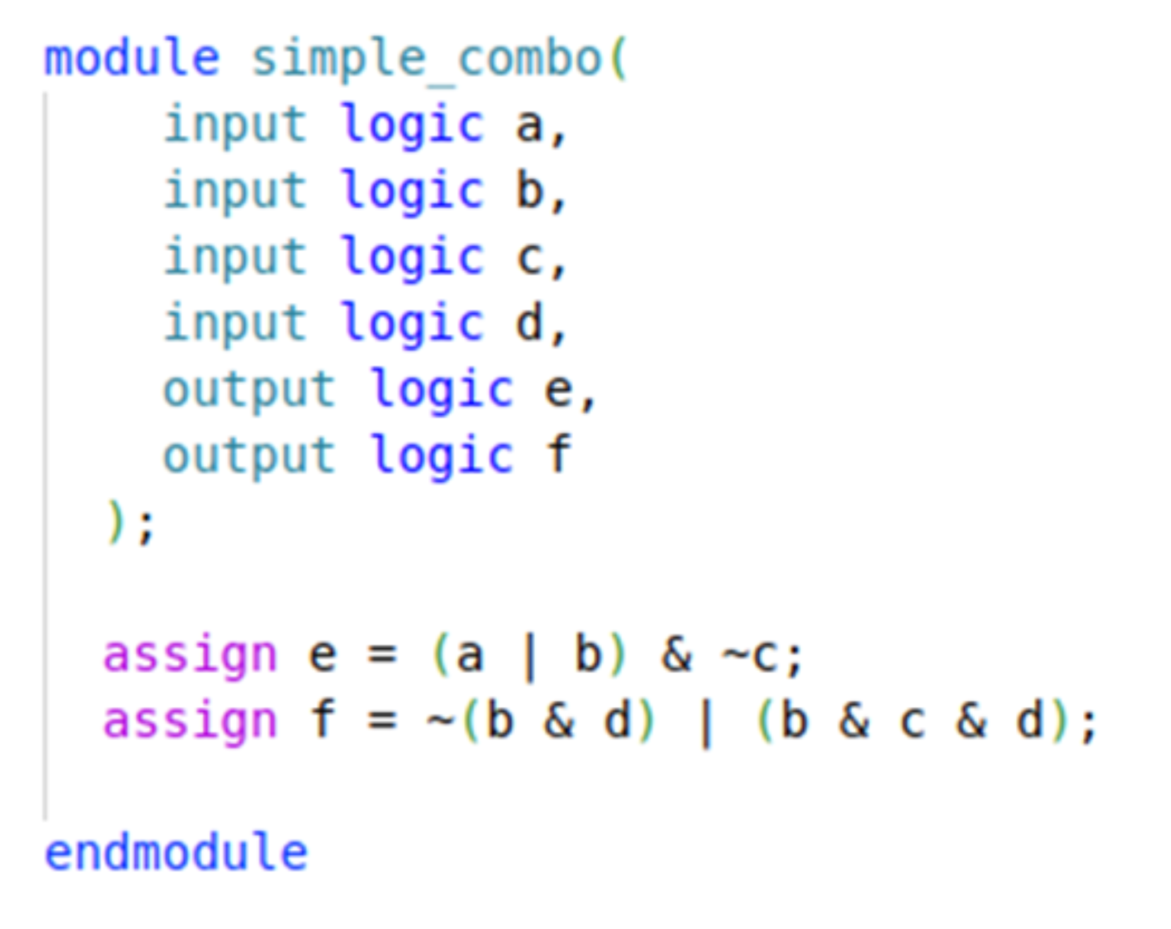
Logic Design: HDL and Synthesis
When are a thousand words worth more than a picture?
HDL: describe the logic, let the synthesis tool turn it into gates

Slide 12
Design automation
System
design
Logic
design
Physical
design
productivity gap
58% versus 21% annually
40
60
70
< 1979
Simulation
Schematic
entry
Placement &
routing
30
50
2
~ 1983
Tehnology’s
capabilities
Hierarchy,
generators
transistors
on the die
30
40
2
1986
Logic synthesis
30
2
1988-92
Designer’s productivity
High-level synthesis /
System-level synthesis
10
2
1992-95
time
Specialized
high-level synthesis
today
Person months /
20 000 logic gates
3
2
~1996-...
Notes:
Adapted from: https://ati.ttu.ee/~jaan/verification/1_introduction%20english.ppt

Slide 13
Digital IC FLOW
Requirements Negotiation | Verification
Specification | Verification
RTL Logic Design | Verification
Synthesis | Verification
Implementation & (Place & Route) | Verification
Bitstream or Layout (GDSII) | Validation | Emulation
Specification
Requirements Negotiation
RTL Logic Design
Synthesis
Bitstream or Layout (GDSII)
Specification Review
Test Plan
RTL Simulation
Formal Verification
Post- Synthesis Verification
Equivalence checking
Validation
Emulation
Implementation & (Place & Route)
Post-implementation Verification

Slide 14

Verification Engineers
Some figures:
2-4 verification engineers per designer
Verification takes 70-85 % of total cost of chip design
Why Verification matters?
Notes:
Adapted from https://ati.ttu.ee/~jaan/verification/1_introduction%20english.ppt

Slide 15

Verification Engineers
*https://www.ziprecruiter.com/Salaries/Entry-Level-Design-Verification-Engineer-Salary
Notes:
Adapted from https://ati.ttu.ee/~jaan/verification/1_introduction%20english.ppt

Slide 16
Why Verification Matters
$250+ million investment just to get started.
Bugs found pre-fab cost project lines of Code; bugs found after tapeout cost millions.. Possible harm to people
Re-spin (design correction and re-fabrication) is long and costly
Around $25 million per re-spin.
Best chance of minimizing bugs ???
Proper Verification

Slide 17


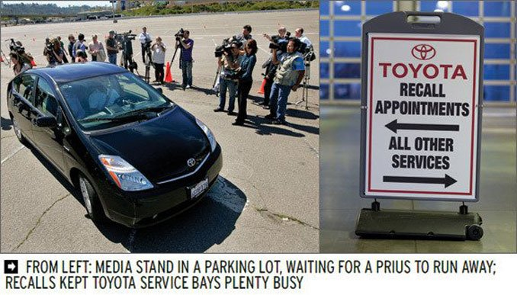
When things go wrong...
1985-1987 - Therac-25 medical accelerator. At least 5 patients die.
1993 - Intel Pentium floating point divide. Costs te company $475 million.
June 4, 1996 - Ariane 5 Flight 501. Rocket disintegrates 40 seconds after launch.
February 2010 - Toyota Prius failure. Toyota loses its market share.
Notes:
Adapted from: https://ati.ttu.ee/~jaan/verification/1_introduction%20english.ppt

Slide 18
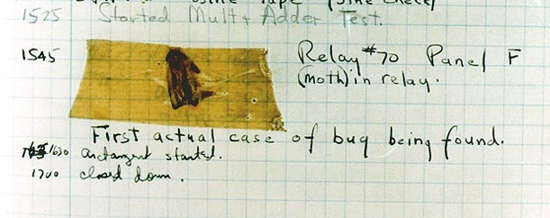
The first bug found
Harvard Mark II system, 1945
Notes:
Adapted from: https://ati.ttu.ee/~jaan/verification/1_introduction%20english.ppt

Slide 19
Types of verification
Mixed-signal
Digital
Analog, RF, etc.
Functional, timing, layout, electrical
Notes:
Adapted from: https://ati.ttu.ee/~jaan/verification/1_introduction%20english.ppt

Slide 20
Digital Logic verification
Functional
Formal
Post-Synthesis
NOTE: In this class, we are going to tie everything to a specification
Notes:
Adapted from: https://ati.ttu.ee/~jaan/verification/1_introduction%20english.ppt

Slide 21
Functional Verification
Process of demonstrating that a design works as specified.
I.E design functions as it is expected to by whoever asked for it to be created.

Slide 22
Formal Verification
Process of converting the behavior described in the specification requirements into mathematical functions known as formal model.
Then checking that the design satisfies properties also derived from the specification.

Slide 23
Post-Synthesis Verification
Process of demonstrating that the design, once converted from HDL into low level gates and implemented in the physical world still behaves as described in the specification.

Slide 24
Verification flow

Slide 25


Slide 26
Lab 1
Get ubuntu VM running/ School server instance??
Installs
vs code
TerosHDL extension
verilator
Iverilog
Yosys
pyverilog

Slide 27
Requirement and Plans
Segment Outcomes
Students will be introduced to functional hardware requirements.
Students will be introduced to logic test plans.
Students will learn how to derive test plans from hardware specifications.

Slide 28
Functional Logic Specification
Functional requirements of how what a design is expected to do at completion…. Not how but WHAT.
Should be at the bounded by the abstraction level of design.
I.E. CPU spec should be at memory/bus/instruction level. ALU requirements should be in a separate ALU spec

Slide 29
Functional Logic Specification
Requirements should be limited to input and output ports
Unnecessary requirements lead to confusion and should be pushed back against

Slide 30
Example: UART Tx/Rx
UART: Universal Asynchronous Receiver/Transmitter.
2 wire serial bus
TX and RX
Baudrate: clock to baud clock.
i.e 50MHZ clk to 115200 baud = 50000000 / 115200 or…
434.027778 clocks per serial baud tick.
Round down???

Slide 31
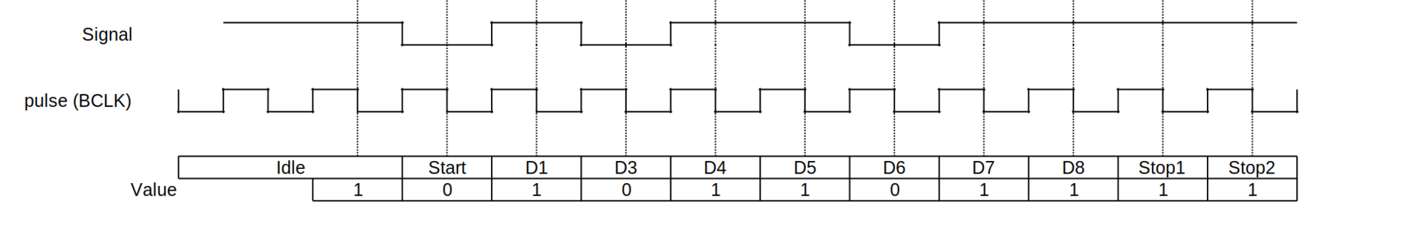
Example: UART Tx/Rx CTND.
UART frame consists of 5 elements:
Idle (logic high)
Start bit (logic low (0))
Data bits
Parity bit
Stop (logic high (1))

Slide 32
Uart Design Spec: Ports
Inputs:
clk_50m: 50Mhz clock
wr_en: write enable
rx: uartreceive signal
rdy_clr: clear ready signal
din: 8 bit data into tx side
Outputs:
tx: uart transmit signal
tx_busy: transmit busy signal
rdy: uart rx ready/ valid rx signal
dout: 8 bit rx data

Slide 33
Uart Design Spec: RX Functional Requirements
Module shall: track transactions on it rx signal following the uart protocol.
Module shall: output received data on dout immediately following a uart rx transaction.
Module shall: output received data on dout immediately following a uart rx transaction.
Module shall: deassert rdy one clock cycle after rdy_clr is asserted.

Slide 34
Uart Design Spec: TX Functional Requirements
Module shall: transmit transactions on it tx signal following the uart protocol.
Module shall: when wr_en is asserted, transmit the data in din on the tx line as a uart tx transaction.
Module shall: only while actively transmitting, assert the tx_busy signal, otherwise deassert tx_busy.

Slide 35
Uart Design Spec: TX Functional Requirements
Requirements Negotiation:
Module shall: only while actively transmitting, assert the tx_busy signal, otherwise deassert tx_busy.
Module shall: while actively transmitting, assert the tx_busy signal.
Module shall: while not actively transmitting, deassert tx_busy.

Slide 36
Universal Serial Bus (USB)
a two-wire serial communication link that runs at either 1.5 or 12 megabits per second (mbs).
Vdd, D+, D-, GND
USB has many layers. We’ll focus on Protocol layer

Slide 37
USB Bus Topology
USB connects USB devices with the USB host
Host
Hub
Hub
Hub
Hub
Func
Func
Func
Hub
Func
Func
Hub can be connected to host/hub/func
Func is the device being connected to host

Slide 38
Uart Protocol Layer
Transmitted in packets (LSB to MSB)
Sync field
PID
Address
Data
Endpoint
CRC
EOP

Slide 39
Test Plan
Specification document that captures all the details needed for verifying a given design.
Will encompass all aspects of the design from concept to delivery.
Verification engineer is responsible for developing this plan initially as he understands the details of the DUT (Design under Test).
Verification plan is a subsegment of the overall Testplan.

Slide 40
Test Plan
Critical in avoiding failures later in a project.
which can include bug escapes
re-working several infrastructure work / time crunches
loosing on quality/features.
What, How, When.

Slide 41
What To Test
Test plan should list down details on what all features of design to be verified.
List all features that should will be tested as individual test items.
Account for all supported design configurations (register settings) under which features should be tested as test plan items.

Slide 42
What to Test ctd.
capture specific micro-architectural cases that needs to be ensured for correctness.
state machines, FIFOs, arbitration and other logical block interactions
specific stimulus patterns, interactions, high level usage scenarios, potential deadlock/livelock conditions

Slide 43
How to Test
Determine the best way to verify each test item.
Most items will be checked by functional verification and constrained random stimulus.

Slide 44
How to Test
Some requirements will be best covered by Formal Verification
Some can be checked by emulation
Some items will be checked by Visual inspection
Figure out how best each of the items can be verified

Slide 45
When to Test
Project timeline.
Verifiers are expected to test more and more, in less and less time.
Test plan needs to capture estimates for timeline of completion.
Estimates should be modular. Parallelize when possible.
Determine Item priorities based on schedule.
Usually at least three:
High, Medium, Low

Slide 46
Problems during Testing
Errors in spec, implementation, language
No way to detect bugs in the spec, because reference object is missing.
Thus: verification by redundancy.
Problem: How to measure verification quality i.e. coverage? (except in equivalence checking)

Slide 47
Test Plan Contents
Verification Plan
Pre-synthesis
Validation Plan
Post-Synthesis
HASS and Halt Plan
Stress testing
Acceptance Criteria
EMF, Board Testing, Electrical paths… ETC.

Slide 48
Verification Plan
Closely tied to the hardware specification and contains a description of what features need to be exercised and the techniques to be used.
Steps may include:
Directed or random testing
Assertions
HW/ SW co-verification
Emulation
Formal proofs
Use of verification IP.
SystemVerilog for Verification

Slide 49
Verification Basics
The most important principle you can learn as a verification engineer is: “Bugs are good.” Don’t shy away from finding the next bug, do not hesitate to ring a bell each time you uncover one, and furthermore, always keep track of each bug found. – some guy probably
SystemVerilog for Verification

Slide 50
Revisit Uart Ports
Inputs:
clk_50m: 50Mhz clock
wr_en: write enable
rx: uartreceive signal
rdy_clr: clear ready signal
din: 8 bit data into tx side
Outputs:
tx: uart transmit signal
tx_busy: transmit busy signal
rdy: uart rx ready/ valid rx signal
dout: 8 bit rx data

Slide 51
Revisit Uart RX Functional Requirements
Module shall track transactions on it rx signal following the uart protocol.
Module shall output received data on dout immediately following a uart rx transaction.
Module shall output received data on dout immediately following a uart rx transaction.
Module shall deassert rdy one clock cycle after rdy_clr is asserted.

Slide 52
Revisit Uart TX Functional Requirements
Module shall transmit transactions on it tx signal following the uart protocol.
Module shall, when wr_en is asserted, transmit the data in din on the tx line as a uart tx transaction.
Module shall, only while actively transmitting, assert the tx_busy signal, otherwise deassert tx_busy.

Slide 53
Verification plan: How do we verify this
RX side
We’ll need to drive RX
Verify that dout outputs correct data
Verify that rdy is 1 after transfer.
Verify that rdy goes low when rdy_clr is 1
TX side
We’ll need to put data on din then assert wr_en
Verify that it transmits the data on din.
Verify that tx_busy is on when transmitting.
Verify that it’s transmitting at the right frequency

Slide 54
Verification plan: How do we verify this
What about clk
Recall baud clock is 50000000 / 115200 = 434.027
Going to have some offsets
What is the error margin on the design?
Can it handle a “bad” clock.

Slide 55
Logic Simulation Segment
Outcomes
Students will be introduced to logic simulation concepts
Students will understand the basic algorithms behind HDL simulators.
Students will understand the difference between cycle based and event based logic simulators.

Slide 56
Simulation-based verification

Slide 57
Logic Simulation
Need a way to check that RTL (Register transfer level) Hardware description is doing what we expect it to do.
Simulate how logic designed will behave when given certain stimulus.
Simulation environment is usually controlled by a top level testbench that instantiates the design as a DUT.
Often with a waveform to view data flow into and through design.
Cycle-Based and Event-Based

Slide 58
Circuit Modeling
Electronic system level
SW + HW
Cycle accurate modeling
C/C++, SystemVerilog, Python
Register-Transfer Level (RTL)
Define bit and timing accurate architecture
VHDL and Verilog. Python? C/C++?
Logic/cell/ gate
Interconnected Boolean operation gates
Work well for logic design, verification, testing.

Slide 59
Level of Circuit Modeling
Switch
Interconnets of “Perfect” transistor switch
Most simulation is at this level
Timing
Use transistors with device models.
i.e switch on/off time
Post Place & Route verification
Circuit
Lowest level, truest accuracy available in simulation
Get timing by solving interdependent equations of branch/loop current and node voltage

Slide 60
Logic State for Simulation
Two state (0,1) for combinational and sequential circuits that are properly initialized.
Note: this is the behavior in hardware… no “x” in HW.
Four states (0,1,X,Z) for uninitialized sequential circuits.
Z for high impedance, used when you aren't driving the output of a signal, so that some other process can drive it.
X(Unknown State) for cases when logic value cannot be calculated.
Such as, uninitialized FF, memory, bus, etc.

Slide 61
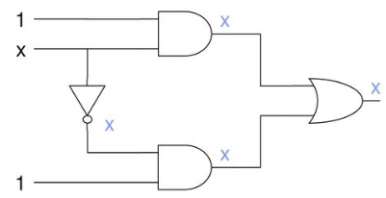
Logic propagation of X
What happens when we treat “x” as a signal
Not x = x
x+x =x
Problem?
We start to lose information
Output should be 1 but due to x’s we get x.
AND | 0 | 1 | X
0 | 0 | 0 | 0
1 | 0 | 1 | x
X | 0 | X | X
OR | 0 | 1 | X
0 | 0 | 1 | X
1 | 1 | 1 | 1
X | X | 1 | X

Slide 62
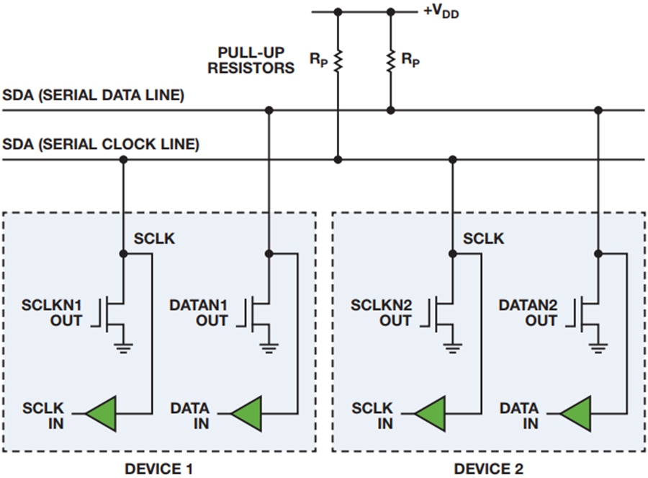
High Impedance
Floating state: node with no path to vdd or gnd.
Logic state of Z can be determined dynamically
Single floating node
Keeps value driven before becoming floating
A set of floating node get connected
A floating node connected to Vdd/Gnd becomes 1/0.
Multiple sources driving a floating node, the value depends on strength of the driving logic.

Slide 63
Modeling Levels and Signals
Level | Circuit Description | Signal | Timing Resolution | Application
ESL | SystemC | 0,1 | Transaction | System
Behavior | HDL | 0,1 | Cycle | Architecture
Logic | Gate-level HDL | 0,1,X,Z | Zero, unit, multiple cell delays | Logic design and test
Switch | Transistor, RC interconnects | 0,1,X | Zero, possible gross-grain timing | Full-custom logic verification
Timing | SPICE | Analog | Fine-grain time | Timing verification
Circuit | SPICE | Analog | Continous time | Timing/analog verification

Slide 64
Simulators
Open Source
Verilator – C/C++
Icarus Verilog - Verilog
GHDL – VHDL
Commercial
QuestaSim
Xcellium

Slide 65
Simulation Phases
Coordinate the testbench so all the code for a project works together.
Build
Generate Configuration
Build Environment
Reset the DUT
Configure the DUT based on generated configuration
Run
Start environment
Run the test
Wrap-up
wait for the final transactions to drain out of the DUT
Report.
SystemVerilog for Verification

Slide 66
Simulation: Cycle based
Computes steady state response of a circuit at each clock cycle.
It does not simulate detailed circuit timing, but instead computes the steady state response of a circuit at each clock cycle.
User observes circuit signals once per clock cycle. Cycle based simulators work only with synchronous designs.

Slide 67
Simulation: Cycle based
Available simulators that are cycle based include:
Verilator
VCS
NCSIM

Slide 68
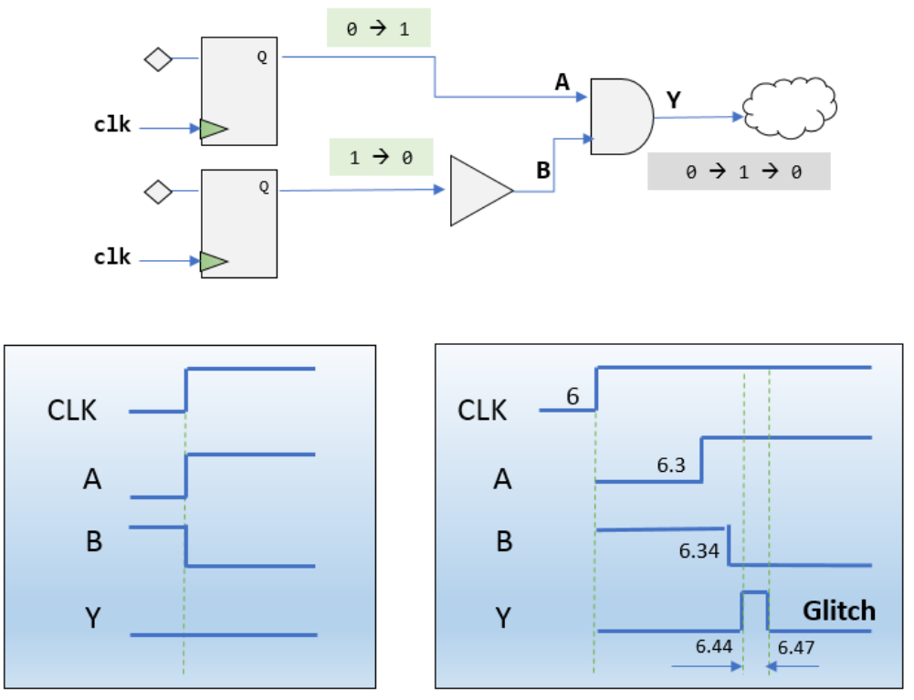
Simulation: Cycle based
Lack of detailed circuit timing means the user cannot see the glitch behavior of signals between clock cycles.
Notes:
https://i0.wp.com/semiengineering.com/wp-content/uploads/2019/07/Synopsys_which-glitch-is-which-fig1.png?ssl=1

Slide 69
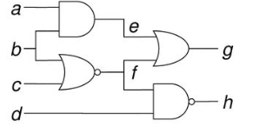
Cycle-based
Circuit is simulated by executing compiled code of the circuit.
Levelization
To ensure that a signal is evaluated after all its sources are evaluated
Levelization Process
Assign all Primary Inputs to 0
Level of gate G is Lg = 1 + max(L1,L2,..)
Where Li’s are G’s input gates
Level 0: a, b, c, d
Level 1: e, f
Level 2: g, h

Slide 70
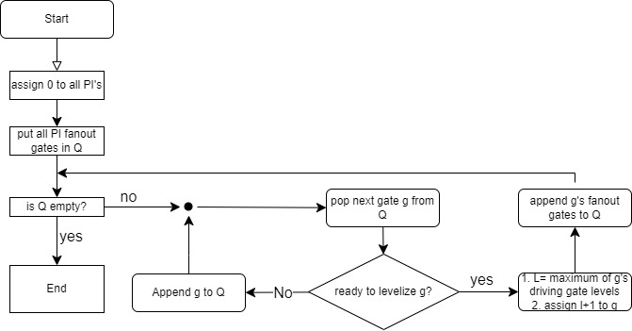
Levelization algorithm flow

Slide 71
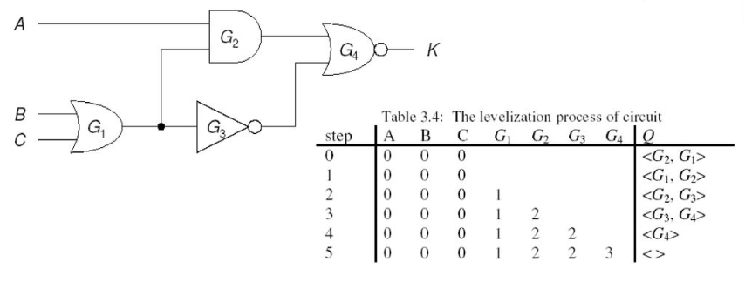
Example of Levelization
Order produced by flow
G1 => G2 => G3 => G4
G1 => G3 => G2 => G4

Slide 72
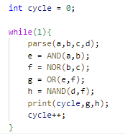
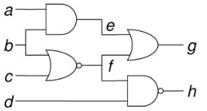
Cycle-based simulation
Effective for 2-state (0,1) simulation
Very fast
Can be compiled directly into machine language
Mostly useful for functional verification, when timing is not analyzed
Will miss glitches.. i.e signals changing in between clock edges.

Slide 73
Verilator
Verilator is a tool that compiles Verilog and SystemVerilog sources to highly optimized (and optionally multithreaded) cycle-accurate C++ or SystemC code.
The converted modules can be instantiated and used in a C++ or a SystemC testbench, for verification and/or modelling purposes.

Slide 74
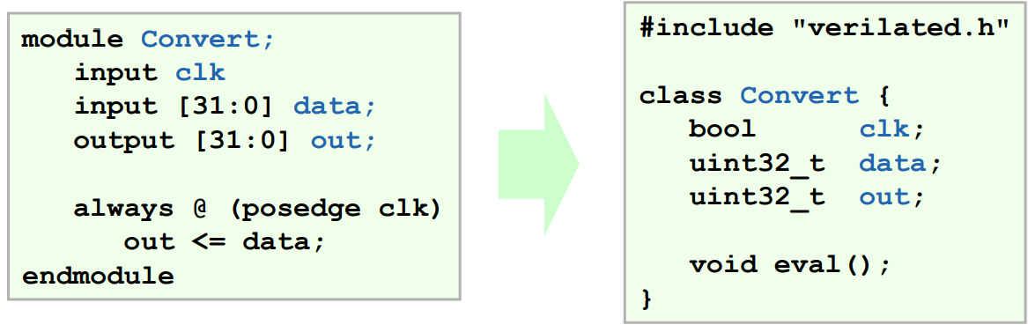
Verilator HDL to C Conversion
The top wrapper looks like the top Verilog module.
Inputs and outputs map directly to bool, uint32_t, uint64_t, or array of uint32_t’s:
Notes:
Verilator Internals, July 2005

Slide 75
Downsides of Cycle-based simulation
Zero-delay model
Perfect switch assumption
Timing problems. i.e glitches, race conditions are ignored
Simulation time
Every circuit is evaluated at every cycle even though typically only 1-10% of signals change at any time.

Slide 76
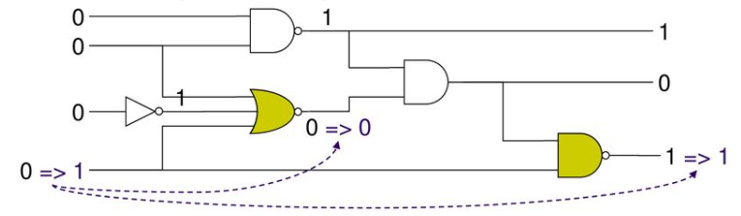
Event-Based simulation
Event is defined as a change in value of a signal, input or internal.
Event based simulator evaluates a gate (element) only if one or move events occur at its inputs
Minimizes the amount of computation done
Follows path of signal flow

Slide 77
Simulation: Event Based
Intermediary and output signals update whenever there’s a change in an input signal.
Allows for simulating designs with possible glitches.

Slide 78
Event-Based simulation
Allows for post-synthesis and timing-based simulation.
Event based simulation very slowed compared to Cycle based since it must simulate much more behavior.

Slide 79
Event-Based simulation
Available Simulators that are Event Based:
Most commercial simulators are event based
QuestaSim
Vivado
Xcelium
Icarus Verilog. *Open source*

Slide 80
Basic Principles
Designed to eliminate unnecessary gate simulations without introducing an unacceptable amount of additional testing.
An event is defined to be a change in the value of a net.

Slide 81
Basic Principles: Event Based
Main function of an Event Driven simulator is to detect events, and schedule gate simulations in response to them
Two times when it is necessary to test nets for changes
when a new input vector is read
immediately after a gate is simulated.

Slide 82
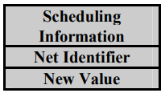
Event-Based Sim Basic Principles Ctd.
Two times when it is necessary to test nets for changes
when a new input vector is read
immediately after a gate is simulated.

Slide 83
Input Simulation
When an event is detected, an event structure must be created and stored for future processing.
Event Queue will be used to store any events that have been detected and not yet processed.
Notes:
Algorithm 3-1. Input Vector Processing.

Slide 84
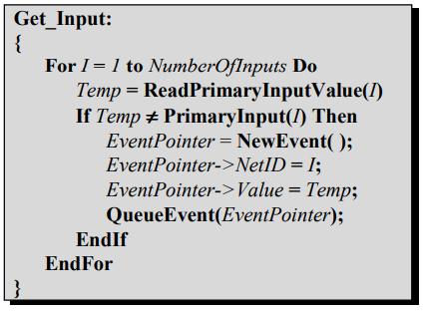
Input Processing Algo.

Slide 85
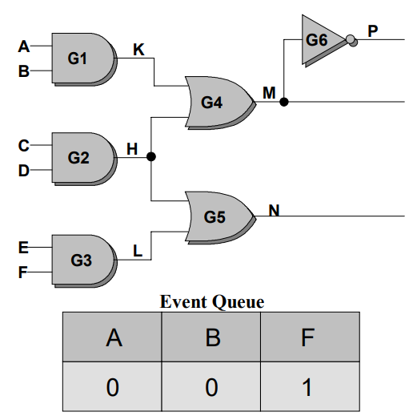
Input Vector Processing
Consider simulating with two consecutive input vectors
(1,1,0,0,1,0)
(0,0,0,0,1,1)
Vectors differ in three positions
Events must be created for Net A,B,F.

Slide 86
Event Processing
First part of event processing is to copy net values from the event structures into permanent storage.
second part is to schedule all gates in the fanout of a net for simulation.
place the identification of the gate into another queue called the Gate Queue.

Slide 87
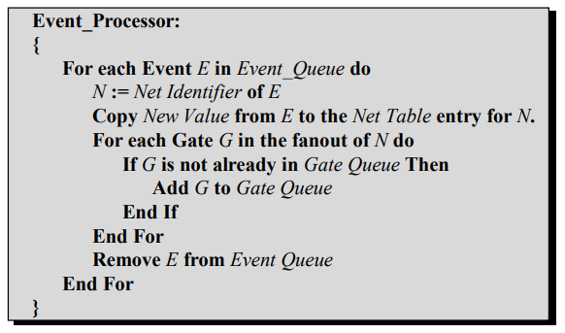
Event Processing Algo.

Slide 88
Gate Processing
After Event Processing, simulate each gate in gate queue
Also, necessary to test the output of each simulated gate for changes and schedule events.

Slide 89
Gate Processing
Gate simulation creates new events and places them in the Event Queue.
Simulation of an input vector consists of a single call to the Input Processing Routine, and several calls to the gate and event processors.

Slide 90
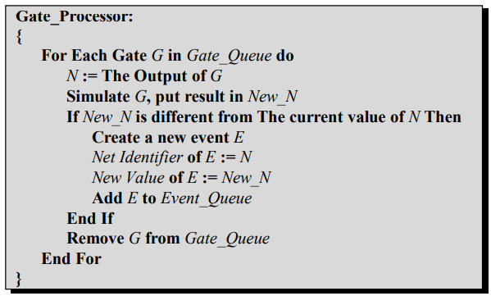
Gate Processing Algo.

Slide 91
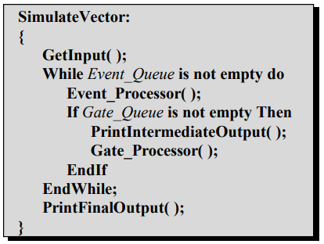
Simulate Vector Alg.

Slide 92
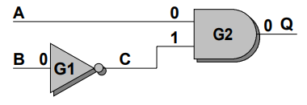
Timing Model
Event based simulation provides a unit-delay model (timescale).
Unlike Cycle-Based simulation which provides zero-delay model (perfect switch).
Example
Initial Values: A=0, B=0, Next Values: A=1, B=1
Cycle-Based Simulation will leave Q at Zero
What happens in Event-Based??

Slide 93
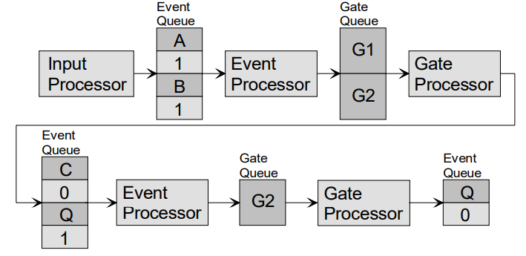
Event-Based Timing Simulation
Input 0 of G2 will propagate first, Q = 1
Input 1 of G2 will then become 0, Q = 0;

Slide 94
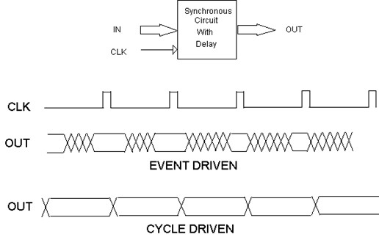
Big Picture: Cycle based vs Event Based

Slide 95
Lab 2
Use pyverilog to parse simple Verilog file
Create two simulators that can accept test vectors in csv format.
Cycle-based
Event-based
Should output a vector or value changes.

Slide 96
Frameworks Segment
Students will be introduced to Non-synthesizable SystemVerilog and its benefits.
Students will be introduced to cocotb and how it compares to SystemVerilog.

Slide 97
Non-synthesizable SystemVerilog
The vision of SystemVerilog was to first expand on the abstract capabilities of synthesizable code.
significantly add all the features known to be necessary for verification.
A strict superset of the previous Verilog standards.
SystemVerilog for Verification

Slide 98
Non-synthesizable SystemVerilog
The benefits of having a single language and a single coherent run-time environment cannot be expressed enough.
Including the design, testbench, and assertion constructs in a single language is that the testbench has easy access to all parts of the environment without requiring specialized APIs.
SystemVerilog for Verification

Slide 99
Data Types
Logic
4 state single bit type
Fixed-Size Arrays
i.e: my_array[5]
Queue
i.e: my_queue[$]
Provides sorting, size.
Typedef
Create new types
SystemVerilog for Verification

Slide 100
Structs
Structs
allows you more control in how data is laid out in memory by using packed structures.
A packed structure is stored as a contiguous set of bits with no unused space.
i.e:
typedef struct packed logic[7:0] {r,g,b) pixel_t;
SystemVerilog for Verification

Slide 101
Enums
Enums
strong variable type that is limited to a set of specified names
instruction opcodes or state machine values.
i.e:
typedef enum {ERROR=0, FIRST=1, Second = 2} my_enum_e;
SystemVerilog for Verification

Slide 102

Data Types
Linked Lists
Yes, they exist in SystemVerilog.
NO, do not use them.
SystemVerilog for Verification

Slide 103
Tasks, Functions, and Void Functions
task can consume time while a function cannot.
A function cannot have a delay
#100, a blocking statement such as @(posedge clock) or wait(ready), or call a task
SystemVerilog for Verification

Slide 104
Tasks, Functions, and Void Functions
Why functions????
Can be synthesized “sometimes”
Can call at the beginning/ or very end of a test.
Void Functions… don’t have a return type.
SystemVerilog for Verification

Slide 105
Time-unit
use timeunit and timeprecision or ‘timescale to unambiguously specify a time value plus units
i.e : 0.1ns or 20ps.
timeunit 1ns; then #1 = wait 1 nano second
SystemVerilog for Verification

Slide 106
Object Oriented Programming
Goal of a testbench is to apply stimulus to a design and then check the result to see if it is correct.
data that flows in and out of design is grouped together into transactions.
easiest way to organize the testbench is around the transactions, and the operations that you perform.
In OOP, the transaction is the object that is focus of your testbench.
SystemVerilog for Verification

Slide 107

Class
Basic building block containing routines and variables.
In Verilog, you need to instantiate a module to use it.
Encapsulates data together with the routines that manipulate it.
Handle
a pointer to an object.
An OOP handle is like the address of the object
stored in a pointer that can only refer to one type.
SystemVerilog for Verification

Slide 108
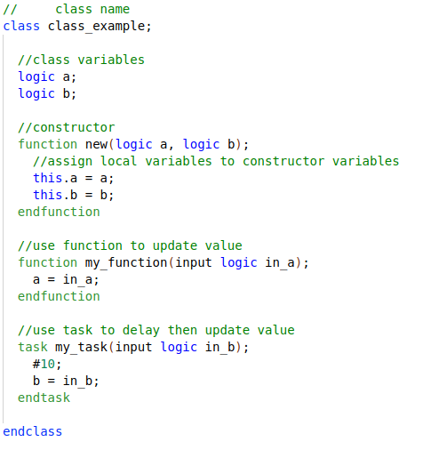
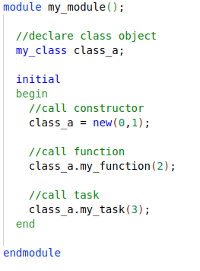
Create Object
SystemVerilog for Verification

Slide 109
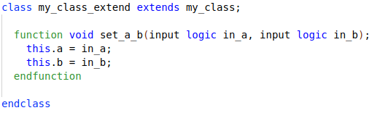
Inheritance
Main “power” of OOP
take an existing class, i.e such as a transaction
selectively change parts of its behavior by replacing routines
but without having to change the surrounding infrastructure.
SystemVerilog for Verification

Slide 110
Interface
Encapsulate related Signals into a block
Same interface can be re-used in other projects
Easier to connect DUT to other verification components I.E classes.
Note:
Interface is essentially a module.. Anything you can do in a module you can do in an interface……
Except it can’t be top module.
Classes must instantiate “Virtual” Interfaces.

Slide 111
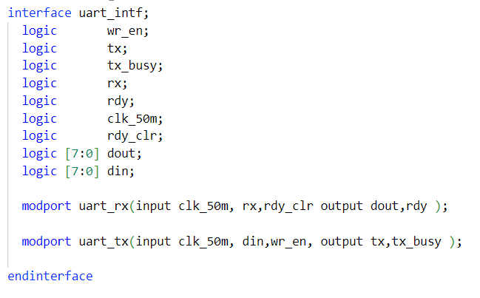
Uart Interface

Slide 112
Virtual Interface
A virtual interface is a variable that represents an interface instance.
Why Virtual Interface
SystemVerilog interface is static in nature, whereas classes are dynamic in nature.
Remember an interface IS a module
Not allowed to declare the interface within classes but can refer to or point to the interface.
Virtual interface is a variable of an interface type
used in classes to provide access to the interface signals.

Slide 113
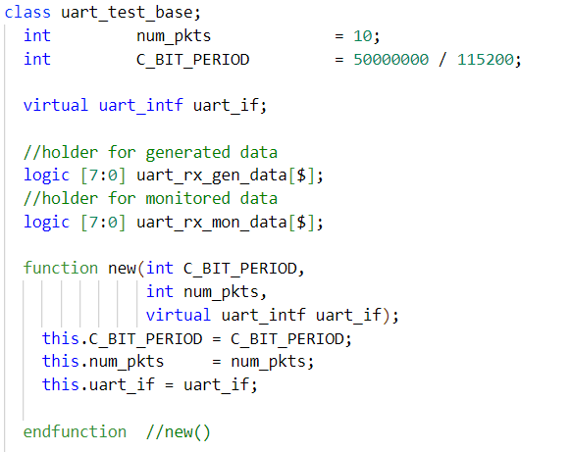
Uart Class

Slide 114
Callbacks
“hook” to inject new code without modifying the original classes.
Your driver may want to:
Inject errors, Drop the transaction, Delay the transaction, Synchronize transaction with others, Put the transaction in the scoreboard, Gather functional coverage data.
SystemVerilog for Verification

Slide 115
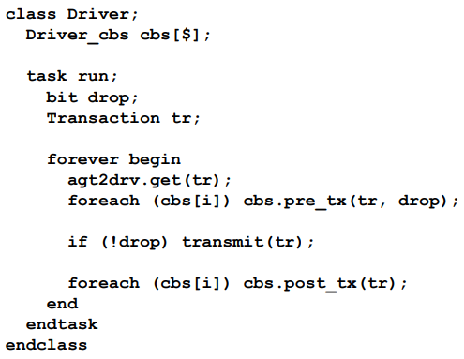
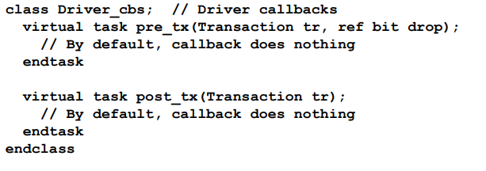
Driver Callbacks
SystemVerilog for Verification

Slide 116
cocotb
Open source coroutine-based cosimulation testbench environment for verifying VHDL and SystemVerilog RTL using Python.
cocotb is all about verification productivity.
It allows developers to focus on the verification task itself, and stop fighting with language limitations.
Cocotb.org

Slide 117
Cocotb: Creating a Test
typical cocotb testbench requires no additional HDL code.
The DUT is instantiated as the toplevel in the simulator without any HDL wrapper code.
access all internals of your design, i.e signals, ports, parameters, etc. through an object that is passed to each test, usually called dut.
Things to note:
Use the @cocotb.test() decorator to mark the test function to be run.
Use .value = value to assign a value to a signal.
Use .value to get a signal’s current value.
Cocotb.org

Slide 118
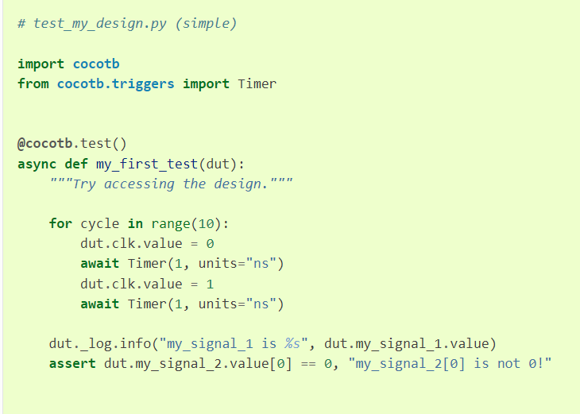
Cocotb: simple testbench
drive 10 periods of a square wave clock onto a port clk of the toplevel.
After,
the clock stops
the value of my_signal_1 is printed
value of index 0 of my_signal_2 is checked to be 0.
Cocotb.org

Slide 119
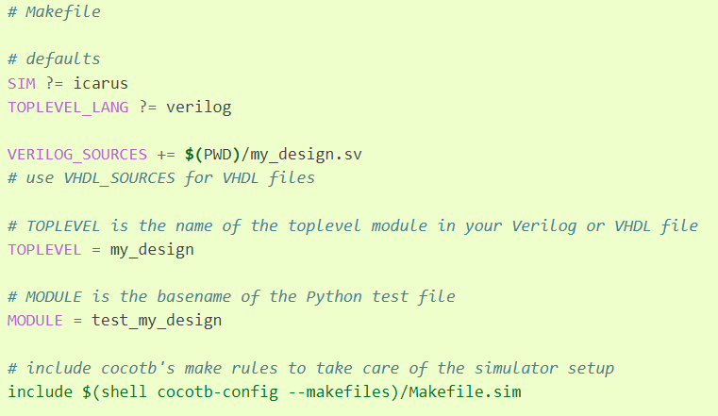
Cocotb: Makefile
In order to run a test, you need to create a Makefile that contains info about your project.
SIM
default simulator
TOPLEVEL_LANG
language of your top module
TOPLEVEL
Name of Top module
MODULE
basename of python test file
Cocotb.org

Slide 120
Testbench Segment
Outcomes
Students will learn the basic concepts of a testbench
Students will learn how and utilize directed testbenches.

Slide 121
Testbench
An overall environment that instantiates or contains the design under test (DUT) with the abilities to apply inputs the design and monitor outputs.

Slide 122
Basic Testbench Functionality
The purpose of a testbench is to determine the correctness of the design under test (DUT).
This is accomplished by the following steps.
Generate stimulus
Apply stimulus to the DUT
Capture the response
Check for correctness
Measure progress against the overall verification goals

Slide 123
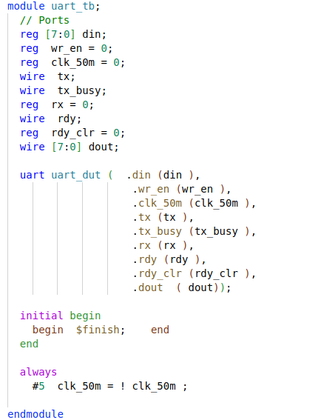
Testbench Basics
Template
Dummy template that declares inputs to and outputs from Design under test (DUT).
Then instantiates the DUT.

Slide 124
Testbench Components
If the real device connects to AMBA, USB, PCI, and SPI buses
must build equivalent components in your testbench that can generate stimulus and check the response.
high-level transactors that obey the protocol, but execute more quickly
SystemVerilog for Verification

Slide 125
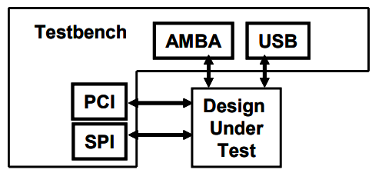
Testbench components
SystemVerilog for Verification

Slide 126
Directed Testing
Manually write stimulus vectors that exercise features in the DUT.
Simulate the DUT with these vectors
Manually review the resulting log files and waveforms to make sure the design does what you expect.
Once the test works correctly, you check off the test in the verification plan and move to the next
SystemVerilog for Verification

Slide 127
Directed Testing Pros?
Incremental approach makes steady progress
produces almost immediate results
since little infrastructure is needed when you are guiding the creation of every stimulus vector.
Given enough time and staffing, directed testing is sufficient to verify many designs.
“I bought five watches the other day. I have a lot of time on my hands….”
SystemVerilog for Verification

Slide 128
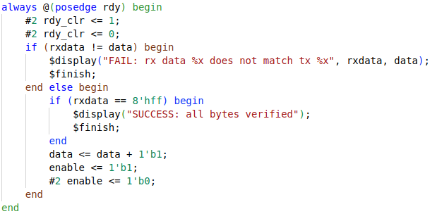
Directed TB: Uart
Clear ready
Check that data in == data out.
Flag if fails
Flag if fails

Slide 129
Directed Testing Cons?
What if you do not have the time or resources to carry out the directed testing approach?
Might always make forward progress but… the slope remains the same.
Test-time scales with design complexity
When design becomes more complex, will take twice as long to verify
Or twice as many people verifying… Project managers will love that ☺.
SystemVerilog for Verification

Slide 130
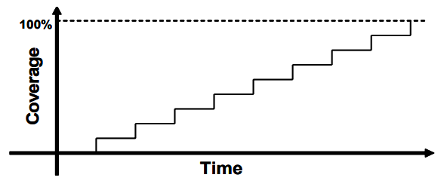
Directed test progress
SystemVerilog for Verification

Slide 131
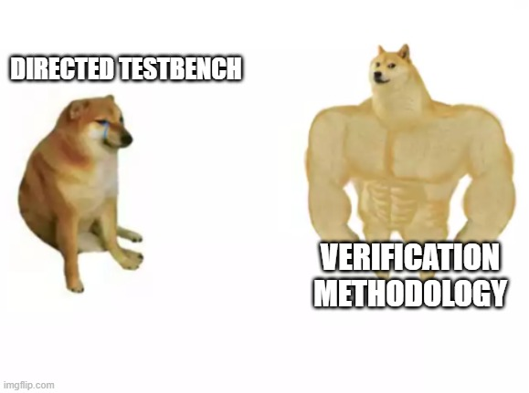
What then?
You need a methodology that finds bugs faster in order to reach the goal of 100% coverage.
You need Methodology
SystemVerilog for Verification

Slide 132
Methodology Segment
Student will learn the basic concepts of design verification methodology.
Sub-Segments
Layered Testbenches
Simulation Phases
Constrained Random Stimulus
SystemVerilog for Verification

Slide 133
Methodology Basics
Layered testbench using transactors
Constrained-random stimulus
Bus Functional Models (BFM)
Common testbench for all tests
Test-specific code kept separate from testbench
Functional coverage
SystemVerilog for Verification

Slide 134
Layered Testbench
key concept for modern verification is the layered testbench.
may seem to make the testbench more complex… but it helps to make your task easier
dividing the code into smaller pieces that can be developed separately.
SystemVerilog for Verification

Slide 135
Layered Testbench
Don’t try to write a single routine that can randomly generate all types of stimulus
both legal and illegal
Inject errors with a multi-layer protocol.
routine quickly becomes complex and unmaintainable
SystemVerilog for Verification

Slide 136
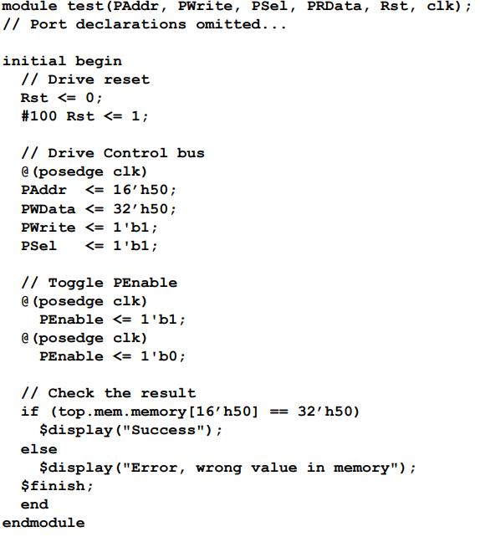
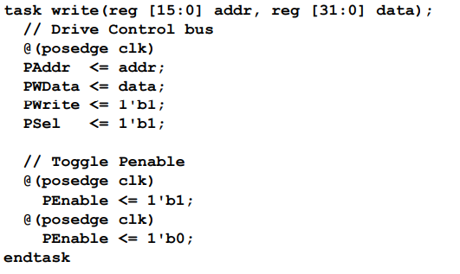
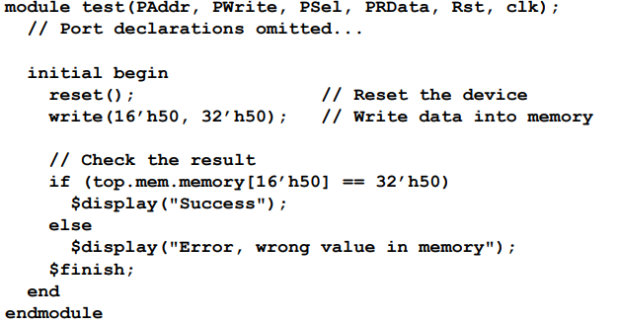
Flat v.s Layered
SystemVerilog for Verification

Slide 137
Methodology: BFM
To the DUT they look like real components … but are part of the testbench, not RTL.
Write “rtl-like” functionality in software without worrying about latches/timing/combinational delays, glitches.
SystemVerilog for Verification

Slide 138
Methodology: Building blocks
What goes into a methodology testbench block?
Layers
Signal Layer
Functional Layer
Scenario Layer
Test Layer
SystemVerilog for Verification

Slide 139

Signal and command layers
SystemVerilog for Verification

Slide 140
Signal and command layers
Signal layer that contains the design under test and the signals that connect it to the testbench
Driver: drives DUT’s inputs with single commands such as bus read or write.
Monitor: driven by the DUT’s output, takes signal transitions and groups them together into commands.
SystemVerilog for Verification

Slide 141
Methodology: Driver
Driver
Drives the generated stimulus to the design.
Could be as simple as a wire….
Or as complex as modeling instructions from rom to processor

Slide 142


Driver: UART

Slide 143
Methodology: Monitor
Monitor
Monitor the design input-output ports to capture design activity
Track data going into and out of the DUT.
Could also use to confirm driver is behaving correctly

Slide 144

Monitor: UART

Slide 145
The functional layer
Functional layer feeds the command layer
Agent: receives higher-level functions and breaks them into individual commands for the driver.
Checker: compares commands from monitor with those in the scoreboard.
Scoreboard: receives commands from agent and predicts the results of the transaction.
SystemVerilog for Verification

Slide 146

The functional layer
SystemVerilog for Verification

Slide 147
Methodology: Testbench Components
Scoreboard
Checks output from the design with expected behavior
Takes in data from both input and output of the design
Confirms that data out was what was expected by the model.

Slide 148

Scoreboard UART RX

Slide 149

Scenario Layer
Generator in the scenario layer drives the functional layer
Orchestrates all these steps with constrained-random values for parameters such as track size and memory location.
SystemVerilog for Verification

Slide 150
Methodology: Generate
Generate
Creates stimulus likely to “stress” design
Ideally trigger as many parts of the design as possible
Example: MP3 player that can do many thing concurrently
plays music from storage
downloads new music from a host
respond to input from the user
such as volume and track controls.
Each of these operations is a scenario.

Slide 151

Generate: Uart

Slide 152
Test Layer
Test:
top level of the testbench
contains the constraints to create the stimulus.
Think of a conductor who does not play any musical instrument, but instead guides the efforts of others.
SystemVerilog for Verification

Slide 153

Test: UART

Slide 154
Parallel random testing
Running with multiple seeds broadens the coverage of your test and leverages your work.
Need to choose unique seed
Time of day? What if you have multiple servers kicking off jobs that start at the same time?
Modern simulators have pretty good seed generation
SystemVerilog for Verification

Slide 155
FORK
Fork???
Multi-thread/ Concurrent Operation
Hardware operates Concurrently, so test must too.
Fork-join: finish when all threads finish
fork-join_any: finish when any thread finish
Fork-join_none: finish immediately run threads in the background.
Each is useful in different situation

Slide 156

Fork Example
All happening at the same time..
At least from the simulations point of view

Slide 157
Functional coverage
Functional coverage:
measures the progress of all tests in fulfilling the requirements in the verification plan.
monitor stimulus going into device, its reaction and response
determine what functionality has been exercised
changes through the project as the various criteria complete.
constantly being modified
not part of the environment
SystemVerilog for Verification

Slide 158
Functional Coverage Roll Up
Combine data from one or more simulations into a report.
Feedback from functional coverage to stimulus
change the test to find new approaches to reach uncovered areas of the design
Example: change the constraint weights based on types of transactions that have been previously generated
SystemVerilog for Verification

Slide 159

Coverage convergence
SystemVerilog for Verification

Slide 160

Test progress with and without feedback
SystemVerilog for Verification

Slide 161

Full Picture
SystemVerilog for Verification

Slide 162
Constrained-Random Stimulus Segment
Explain the basics and benefits of randomized input to the DUT
SystemVerilog for Verification

Slide 163
Constrained-Random Stimulus
Simulator generates the stimulus.
But not totally random values.
Use the verification language to describe the format of the stimulus
“address is 32-bits, opcode is X, Y, or Z, length < 32 bytes”
Allow the simulator to pick values that meet the constraints.
SystemVerilog for Verification

Slide 164
Constrained-Random Stimulus - 2
Coverage may overlap other tests or may explore new areas that you did not anticipate.
If these new areas find a bug, you are in luck! If the new area is not legal, you need to write more constraints to keep away
SystemVerilog for Verification

Slide 165
What Should You Randomize?
First thing that you might think of is the data fields.
Easy peazy: just call $random, or c/python alternative
Problem?
gives a very low payback in terms of bugs found.
primary types of bugs found with random data are data path errors
perhaps with bit-level mistakes.
Need to find bugs in the control logic.
SystemVerilog for Verification

Slide 166
What Should You Randomize?
Need to think broadly about all design input, such as:
Device configuration
Environment configuration
Input data
Protocol exceptions
Delays
Errors and violations
SystemVerilog for Verification

Slide 167

Input Data
Think of implementing a transaction such as a bus write and filling the data fields with random values
Should be easy if you have carefully prepared your transaction classes.
need to anticipate any layered protocols and error injection, plus scoreboarding and functional coverage.
SystemVerilog for Verification

Slide 168
Randomize: configuration
Should randomize the entire environment configuration
including the length of the simulation
number of devices, and how they are configured.
need to create constraints to make sure the configuration is legal.
Consider other environment parameters include test length, error injection rates, delay modes, etc.
SystemVerilog for Verification

Slide 169
Delays and synchronization
How fast should your testbench send in stimulus?
Use constrained random delays to help catch protocol bugs.
test that uses the shortest delays won’t create all possible stimulus.
subtle bugs are often revealed when intermittent delays are introduced.
SystemVerilog for Verification

Slide 170

Genenerate Delays

Slide 171
Delays and Synchronization
When possible, coordinate various drivers so they can communicate at different relative timing.
What if the inputs arrive at the fastest possible rate, but the output is being throttled back to a slower rate?
What if stimulus arrives at multiple inputs concurrently?
What if it is staggered with different delays?

Slide 172
Protocol exceptions
If something can go wrong in the real hardware, you should try to simulate it.
Look at all the errors that can occur.
What happens if a bus transaction does not complete?
Invalid operation is encountered?
SystemVerilog for Verification

Slide 173

Protocol Exceptions: Be provocative!
Does the design specification state that two signals are mutually exclusive?
Drive them both and make sure the device continues to operate.
Be provocative!
SystemVerilog for Verification

Slide 174
Coverage Segment
Students will learn the different types of coverage and how they roll up into test acceptance and confidence.

Slide 175
Coverage Type
Coverage is a generic term for measuring progress to complete design verification.
coverage tools gather information during a simulation and then post-process it to produce a coverage report.
SystemVerilog for Verification

Slide 176
Coverage Type
can use coverage report to look for coverage holes and then modify existing tests or create new ones to fill the holes.
iterative process continues until you are satisfied with the coverage level.
SystemVerilog for Verification

Slide 177
Code Coverage
Code coverage measures how thoroughly your tests exercised the “implementation” of the design specification, and not the verification plan.
Untested design code could conceal a hardware bug or may be just redundant code.
SystemVerilog for Verification

Slide 178
Types of code coverage
line coverage : measuring how many lines of code have been executed which
path coverage: paths through the code and expressions have been executed
toggle coverage: which single-bit variables have had the values 0 or 1
FSM coverage: which states and transitions in a state machine have been visited
SystemVerilog for Verification

Slide 179

Code coverage: block coverage
SystemVerilog for Verification

Slide 180

100% Code Coverage???
Job done?? Not exactly
What about actual functionality?

Slide 181
Functional coverage
Functional coverage is tied to the design intent and is sometimes called “specification coverage,”
what happens if a block of code is missing from the design?
Code coverage cannot catch this mistake, but functional coverage can.
SystemVerilog for Verification

Slide 182
Functional coverage
Functional coverage is tied to the design intent and is sometimes called “specification coverage,”
what happens if a block of code is missing from the design?
Code coverage cannot catch this mistake, but functional coverage can.
SystemVerilog for Verification

Slide 183

coverage: state coverage
Sequence b,a,b,a,b,a,b,a,... gives 66.67% of state coverage, as S1 and S2 traversed (2 out of 3).
S4 is illegal state, thus max state coverage is 75%!
SystemVerilog for Verification

Slide 184

Coverage Report
SystemVerilog for Verification

Slide 185
Let’s Synthesize!
Coverage is at an acceptable level?
Sign off on RTL
Design is synthesized unto low level primitives. Now what?

Slide 186
Logical Equivalence Segment
Students will learn the common faults that can be introduced in the synthesis stage.
Students will learn of common logical equivalence tools and the concepts behind them.

Slide 187
Synthesis Mismatch
Mismatches between RTL and Synthesized Netlist can occur
Remember HDL stands for Hardware “Description” Language.
Synthesis tool can misinterpret what was described.

Slide 188
Practices that lead to Mismatches
Incomplete sensitivity list
Netlist will trigger on any change regardless of sensitivity list
Complete sensitivity list with mis-ordered assignments
Assignments in blocks execute sequentially in RTL sim.
Synthesis will order assignment correctly based on dependencies.

Slide 189
Practices that lead to Mismatches
Functions:
no synthesis tool warnings when function code simulates latch behavior
Improper initialization
Fpga designers can initialize variables… ASICs can’t.
Timing Delays
Placing delays on the left side of always block assignments does not accurately model either RTL or behavioral models.

Slide 190
How do we verify Equivalence?
Verify Netlist through simulation
Use same verification code on netlist.
Most vendors provide simulation libraries for their primitives.
Can be difficult to work with
Google “glbl.v error” later.

Slide 191
How do we verify Equivalence?
Can instantiate both RTL and Netlist in design.
Verify that given the same inputs they produce same outputs.
Problem?
Many synthesis tools will reorder signals to meet timing.

Slide 192
Equivalence checking
It is necessary to match the variable names of the designs under comparison!
We implement canonical forms ...
... or look for an input vector that would distinguish the output responses of two designs. SAT methods. Similar to test pattern generation.

Slide 193
Equivalence checking
Comparison of pre- and post-scan schematics
Comparison of RTL versus transistor layout
Verification of minor changes in the design

Slide 194
Logic Equivalence check
Tool validates the design by injecting random vectors
Conformal from Cadence and Formality from Synopsys
Opensource: Yosys

Slide 195
Logic Equivalence check: Process
Specify Blackbox parts of design.
Read in libraries and designs
Specify design constraints
Specify modeling directives
Switch to LEC mode
Mapping process
Compare process

Slide 196
LEC: Specification of blackbox
Non-essential/Negligible design parts broken down into blocks
i.e analog blocks, memories, and digital blocks.
blocks are treated as blackbox when running LEC.
IPs can be included as blackbox.
makes sure only the I/O ports are read and not the entire design.
cut the runtime by a huge amount and will be of great assistance when we are running LEC on large designs

Slide 197
LEC: Read RTL and Libraries
Read Verilog and VHDL file
Read in standard simulation libraries
built-in Hardware Descriptive Language (HDL) rule check searches for lint errors and warnings.

Slide 198

LEC Specification of design constraints
DFT insertion can create multiple functional modes for design
adding constraints to the design to ensure it is in common functional mode
I.E: Tie scan_enable to zero

Slide 199

LEC Specification of modeling directives
Synthesis can output different netlist optimizations
Power optimized, Area optimized, Effort optimized
Clock gating logic in golden design would be converted to latch-based clock gating.
Need to add modeling directives to match both designs.

Slide 200
LEC Mapping process
maps key points such as
primary inputs (PI), primary outputs (PO), DFFs, D-latches, blackboxes, Z-gates, and cut gates
First will use name-based mapping
Followed by function-based mapping
Name-based mapping takes less runtime than function-based mapping
tools tries to map key points with name-based mapping before switching to function based mapping.

Slide 201
LEC Compare process
Comparison done only on mapped key points.
important that all key points should be mapped
Will try to prove equivalency by passing all combinations of inputs to the logic cone and checks the output behavior.
After running, key points will be categorized as equivalent, inverted equivalent, non-equivalent, and abort points.
If all the compare points come out as equivalent, then we can confidently assert that the golden and revised design are matching.

Slide 202
Formal Verification Segment
Students will learn the basics of formal verification.
Students will be able to apply bounded models to logic designs.
An Introduction to Formal Methods

Slide 203
Formal Verification
Problem with test benches?
Only examines a known good branch
Cannot check for every out of bounds conditions
Demonstrate design works
Through a normal working path – or a limited number of extraneous paths
Never rigorous enough to check everything
Not uniform in rigor
I.E
For a FIFO
Only read when you know it’s not empty
An Introduction to Formal Methods

Slide 204
Simulation-based vs formal

Slide 205
Model-checking
The goal is to find an input assignment violating the assumed property.
If such an assignment (counter-example!) exists then we can simulate it to obtain signal waveforms for debugging.
If there exists no counter-example then we have proven that the implementation matches the property.

Slide 206
Model-checking
Problems:
How do you extract only this portion of the design that is related to the property to be checked. Currently done manually...
Selection of the properties to be checked is tricky...
Bugs may occur in the implementation, in properties or in configuration (i.e. environment).
Roughly 70 % of total effort for setting up the configuration.

Slide 207
Model-checking
Theorem provers
Not very automated but...
handle larger designs, require less memory.
Use higher order logic.
Thus, can check more complex properties.

Slide 208
Formal verification Flow

Slide 209

Basic Premise
Two separate and distinct fashions
First method calculates the answer
Second method proved it was right
Formal is similar
Design is the first method
Formal properties are the second
Example: Division
$$\frac{89,321}{499}=179$$
Does it?
Let’s check: $179∗499=89,321$ — Yes!
An Introduction to Formal Methods

Slide 210

Basic Premise
Example: Division
$\frac{89,321}{499}=179$
Does it?
Let’s check:
$179∗499=89,321$ — Yes!
An Introduction to Formal Methods

Slide 211
Basic Premise
Formal is similar
Design is the first method
Formal properties are the second
An Introduction to Formal Methods

Slide 212
Basics
Assert
An assert ( X ) statement indicates that X must be true, or the design will fail to prove
Assume
An assume ( X ) statement will limit the state space that the formal verification engine examines.
An Introduction to Formal Methods

Slide 213

Assert/assume forms
An Introduction to Formal Methods

Slide 214

General Rule
An Introduction to Formal Methods

Slide 215

Assert
Assertions define the illegal state space.
Additional assertions will increase the size of the illegal state space.
An Introduction to Formal Methods

Slide 216

Assume
Assumptions limit the universe of all possibilities
Additional assumptions will decrease the size of the total state space
Caution: careful not to make assumptions that are impossible
I.E., assume a 4-bit signal is greater than 30
An Introduction to Formal Methods

Slide 217

Bounded Model Checking
For bounded model checking:
Start at the initial state
Examine all possible states for N clocks
Try to find a way to make an assert (); fail
If it’s not possible in N clocks, then pass
An Introduction to Formal Methods

Slide 218


No Solution
Problem: initial assume(!initial_state); Model fails, no line number given.
Problem: assume(!reachable_state); Model fails, no line number given.
An Introduction to Formal Methods

Slide 219
Assertions vs Assumptions
Suggestion,
Any SystemVerilog properties that constraints the input state-space of our DUT are assumptions.
Properties that checks the validity of output signals are assertions.

Slide 220
BMC UART
Consider relationship between inputs and outputs
For this DUT we need to cover forward progress, rdy handshaking, tx_busy propagation.
Uart Protocol??
Testbench/BFM will confirm protocol
Caveat, should be robust enough to find errors in protocol/ protocol violations.

Slide 221


BMC Example
Extra points to suggests some more properties for UART

Slide 222


Slide 223

BACKGROUND: K- Induction
Base case: prove for N = 0/1
Inductive step: Assume true for N, prove true for N + 1
$$Example: prove \sum_{n=0}^{N−1}{x^{n}}=\frac{1−x^{N}}{1−x}$$
For N = 1, the sum is $x^{0}$ or one
$$\sum_{n=0}^{N−1}{x^{n}}=x^{0}=\frac{1−x^{N}}{1−x}$$
So, this is true (for x != 1).
For the inductive step, we’ll
Assume true for N, then prove for N + 1
An Introduction to Formal Methods

Slide 224



BACKGROUND: Proof
$$Prove\sum_{n=0}^{N−1}{x^{n}}=\frac{1−x^{N}}{1−x} for all N$$
Assume true for N, prove for N + 1
$$Prove\sum_{n=0}^{N−1}{x^{n}}=x^{N}+\sum_{n=0}^{N−1}{x^{n}}=x^{N}+ \frac{1−x^{N}}{1−x}$$
Prove for N + 1
$$\sum_{n=0}^{N−1}{x^{n}}=\frac{1−x^{N}}{1−x}x^{N}\text{ + }\frac{1−x^{N}}{1−x}=\frac{x^{N}−x^{N+1}+1−x^{N}}{1−x}=\frac{1−x^{N+1}}{1−x}$$
This proves the inductive case.
Hence this is true for all N (where N > 0 and x != 1 )
An Introduction to Formal Methods

